Slide 1
Imperialism
1800-1914
Notes:
US DVD Clip (4)

Slide 2
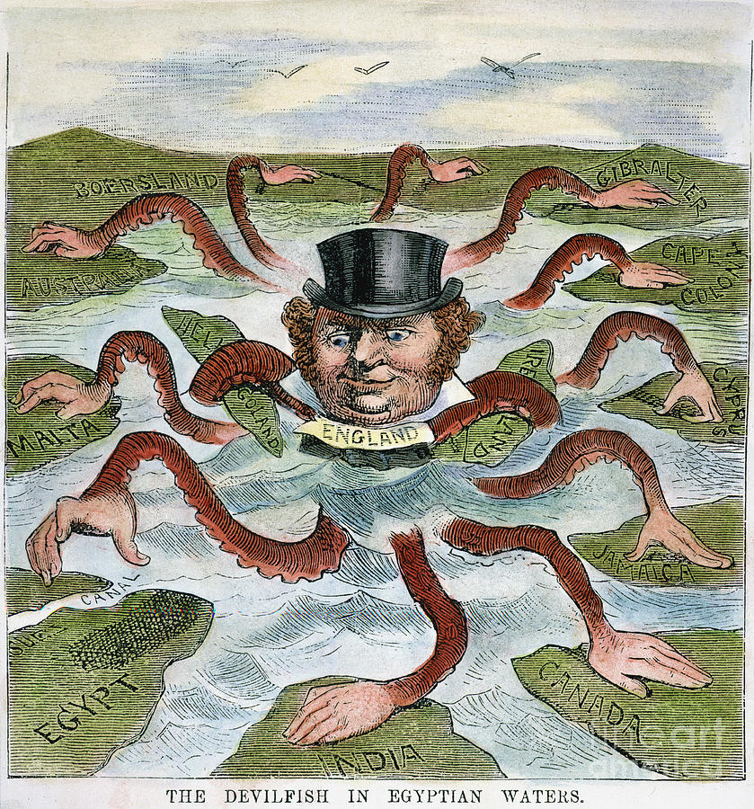
QUESTIONS
How did democracy grow?
What was the purposes of Imperialism?
Why did some people oppose it?

Slide 3
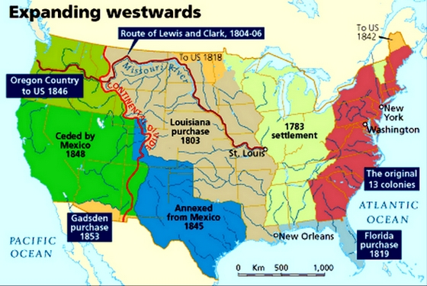
EXPANSION OF THE U.S.
Expansionism
The boundaries of the U.S. were extended
Manifest Destiny
Belief that it was our destiny to expand as a country
Democracy grew
Slaves were freed and African-Americans could now vote
Immigrant explosions
Immigrants helped the economy grow

Slide 4
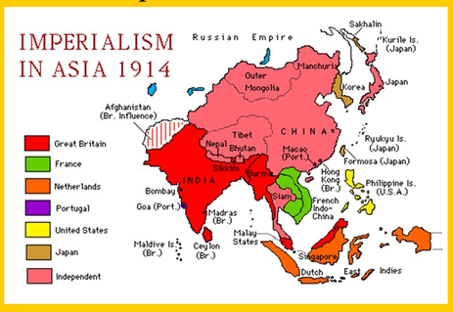
OVERSEAS EMPIRES
Imperialism
One country dominating a different region
Colonies were the main example
Complete control over politics, economics, and culture

Slide 5
WESTERN IMPERIALISM
Weakness across the world
Countries that were not westernized were seen as weak
I.E. countries in Asia, Africa, even South America
Advantages of the West
Technology such as engines, steel, and better developed firearms
Resistance and opposition
Many countries tried to resist imperialism
Many people from the US and other western nations opposed the idea
They did not think it was morally right

Slide 6
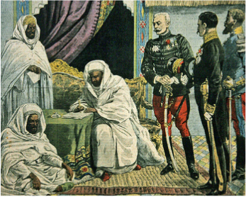
NEW FORMS OF RULING
Puppet rulers
Protectorates were put in place as local rulers
They had to swear loyalty to the country that ruled them
The western countries heavily influenced the lands they colonized
Also called the sphere of influence

Slide 7
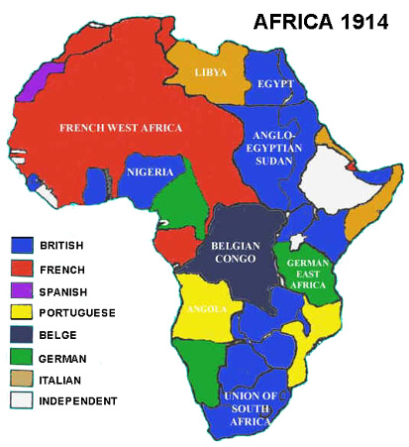
AFRICA’S PLIGHT
Africa was split up by Europe
Different countries owned different sections
Islam returns to Africa in the 1800’s
Used to fight the European influence
There continues to be conflicts between Islamic Africans and Christian Africans to this day
Europeans stop exporting slaves from Africa in the early 1800’s
Middle Eastern countries continued to export slaves

Slide 8
QUIZ!

Slide 9
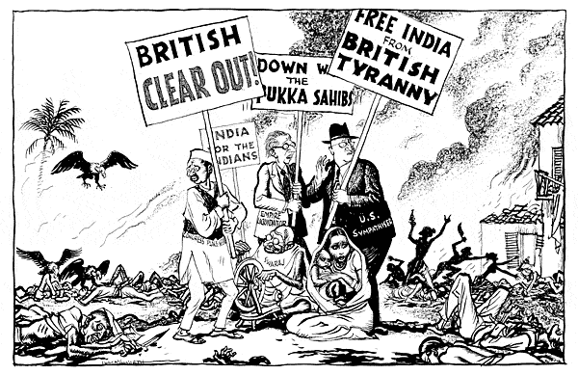
MORE QUESTIONS
How did the Ottoman Empire rule its territories?
What was the benefit of building the Suez Canal?
Why was India the jewel of the British Empire?
Why was the Open Door Policy so important?

Slide 10
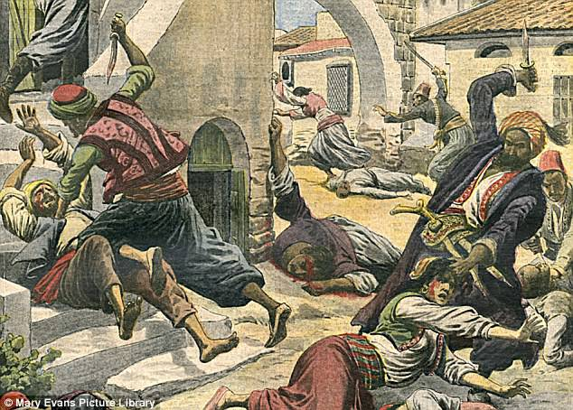
IMPERIALISM IN THE MIDDLE EAST
The Ottoman empire controlled most of the Middle East
Ruled with puppet states
Nationalism causes some internal conflict
The Ottoman Empire made efforts to be like the west
Armenian Genocide
The Armenians were Christians within the Ottoman Empire
Protests and opposition to the Ottomans triggered the Genocide
600,000 to 1.5 Million killed or starved over 25 years

Slide 11
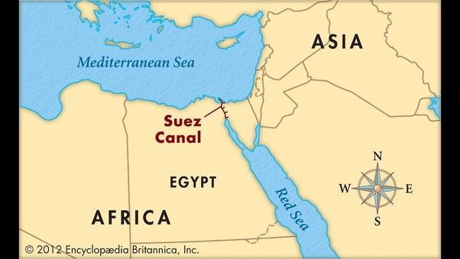
IMPERIALISM IN THE MIDDLE EAST
Egypt Begins building the Suez Canal
1858-1875
Connects the Mediterranean Sea with the Red Sea
Made trade easier
Owned by the British

Slide 12
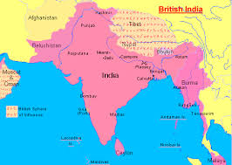
INDIA AND THE BRITISH
The British were able to divide the people of India to take control
Exploited the rivalry between Indian princes
As time went on, the people of India disliked the British more and more
They had rallies, protests, and riots
The Sepoys formed a rebellion, but it was not successful
Even though the Indians did not like the British, India was still considered the jewel of the British Empire

Slide 13
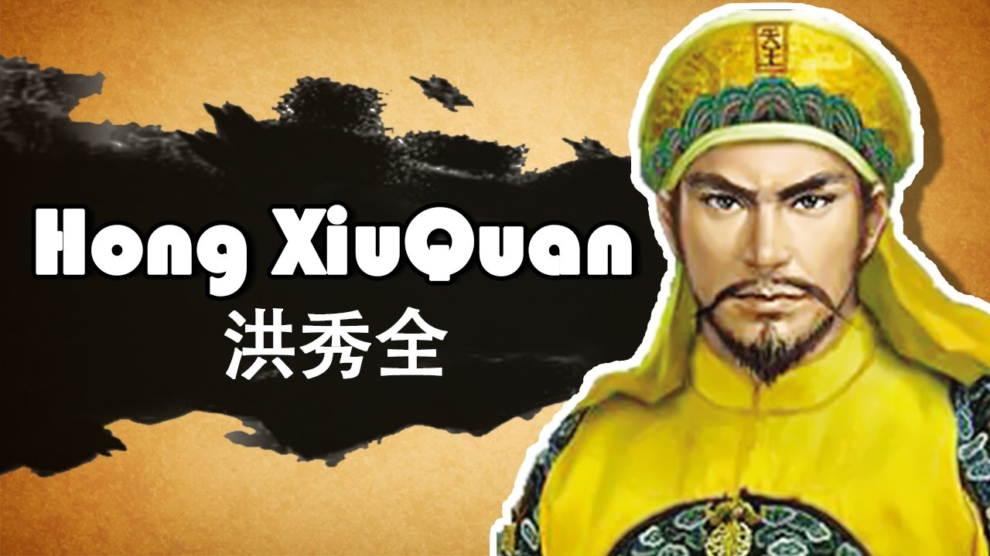
CHINA AND BRITAIN
Opium Wars
China was importing so much Opium from Britain that the economy collapsed
Led to a short naval war that the British won
The British forced several unfair and unequal treaties onto China.
Taiping Rebellion
Led by Hong Xiuquan in 1850
Tried to topple the Qing Dynasty
They wanted to end famine and poverty
The rebel forces were defeated in 1864

Slide 14
CHINA AND JAPAN
Sino-Japanese War
Japan modernized much faster than China
Tension between Japan and China led to war
China lost the war and Japan took Taiwan
Open Door Policy
Made so that everyone could trade with China equally
China became a republic in 1908 when the last member of the Qing Dynasty died

Slide 15
QUIZ!

Slide 16
MORE QUESTIONS
What changes were made during the Meiji Restoration?
Why was the Panama Canal important?

Slide 17
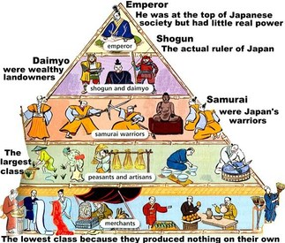
OLD JAPAN
Feudalism
Japan had social classes

Slide 18
WESTERNIZED JAPAN
The U.S. Forced Japan into a treaty for trade
Japan moves it’s capital from Kyoto to Edo
Edo is renamed Tokyo
Meiji Restoration
The Emperor and his leaders began westernizing Japan
New Government modeled after Germany
Stronger military
More trade
New technology
Annexed Korea
War with Russia

Slide 19
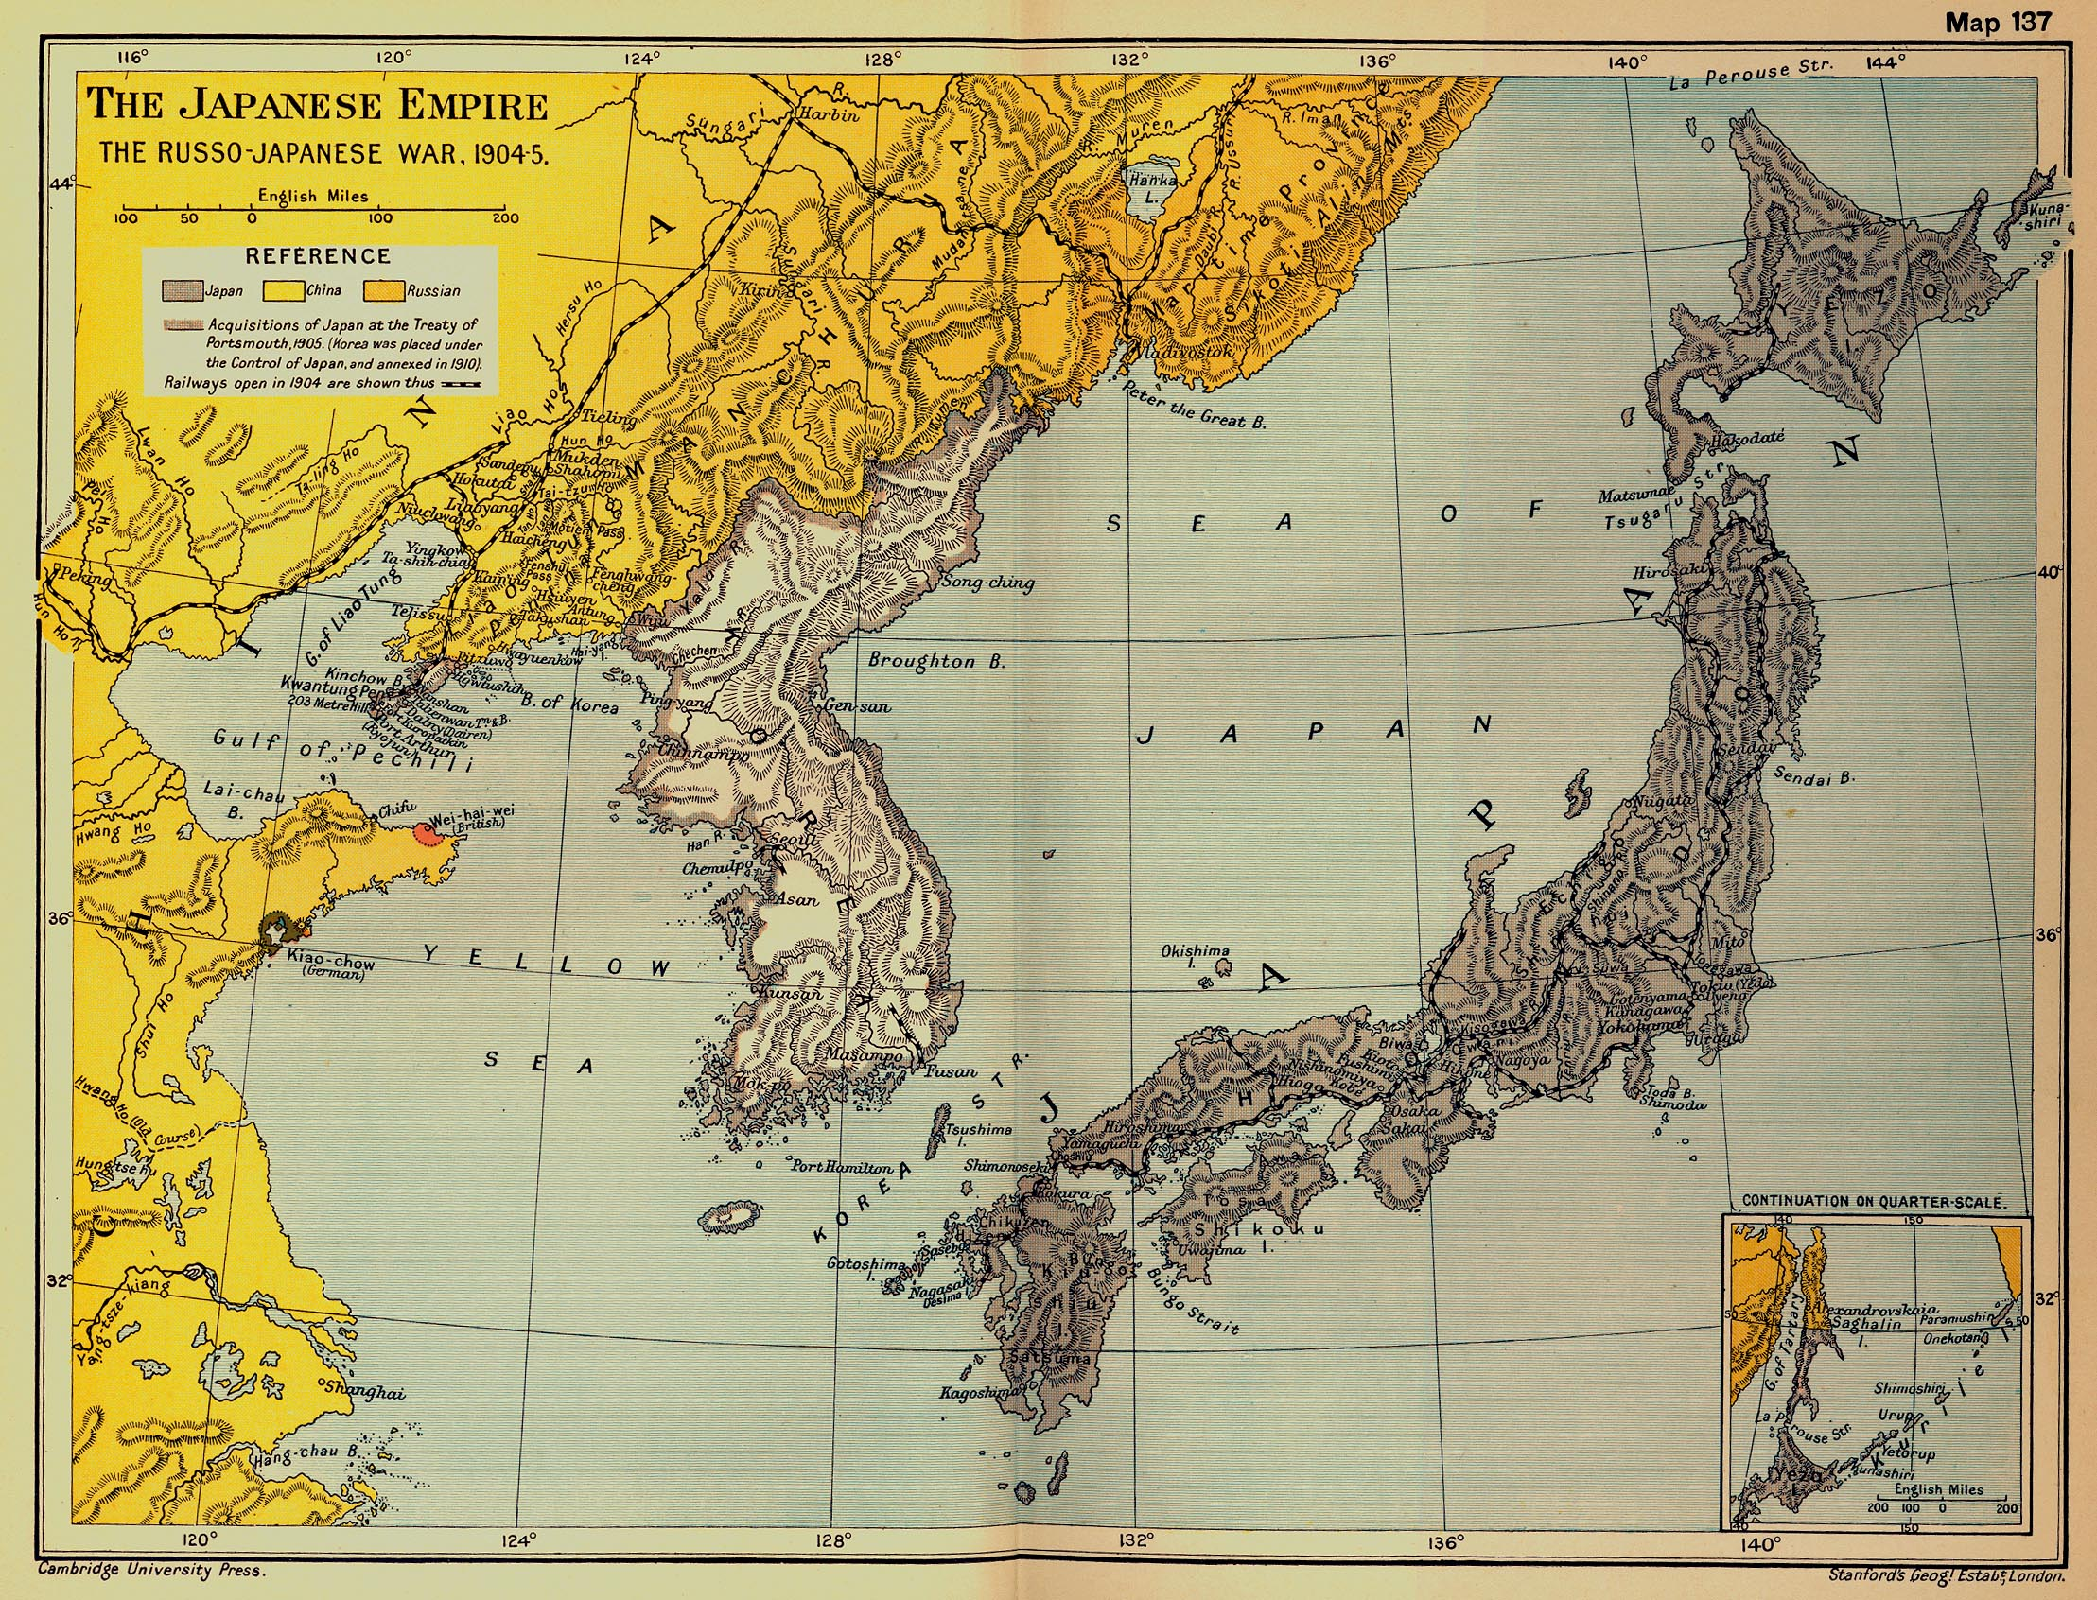
JAPAN EXPANDS

Slide 20
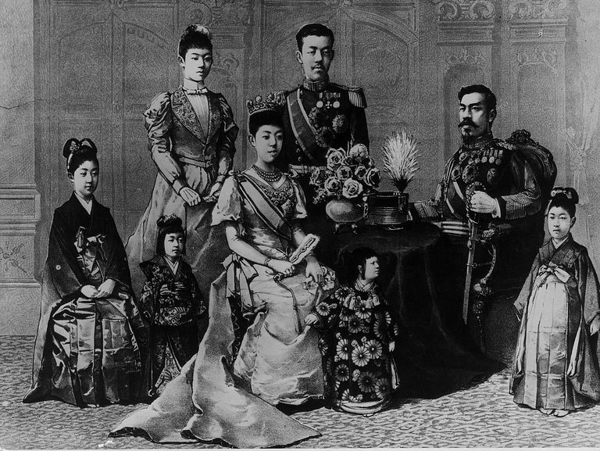
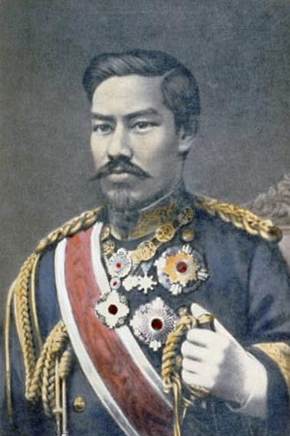
MEIJI RESTORATION

Slide 21
OTHER ASIAN COUNTRIES
East Indies
Dutch
Burma and Malaya
British
French Indochina (Vietnam, Cambodia, Laos)
French
Philippines
Spain; but U.S. won it in the Spanish-American War
Hawaii
U.S.
Siam
Not imperialized

Slide 22
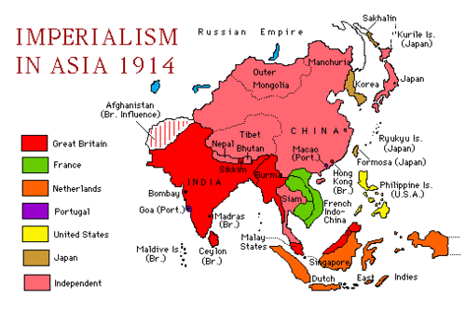
OTHER ASIAN COUNTRIES

Slide 23
MORE IMPERIALISM
Canada
Was owned by Britain
Combined the English speaking and French speaking provinces
Independence as the Canadian Dominion in 1867
Australia
Originally a prison colony for British prisoners
Grew in population during the gold rush
Independence on 1901
New Zealand
British settlers killed most of the Natives (Maori)

Slide 24
IMPERIAL LATIN AMERICA
Mexico
Independence from Spain in 1810
Struggled for Stability
Mexican-American War in 1846 to 1848
The rest of Latin & South America
Chain of Revolutions
Mostly colonies owned by Spain and Portugal
Panama
Panama builds a canal with the help of the U.S.
Connects the Atlantic and Pacific oceans

Slide 25
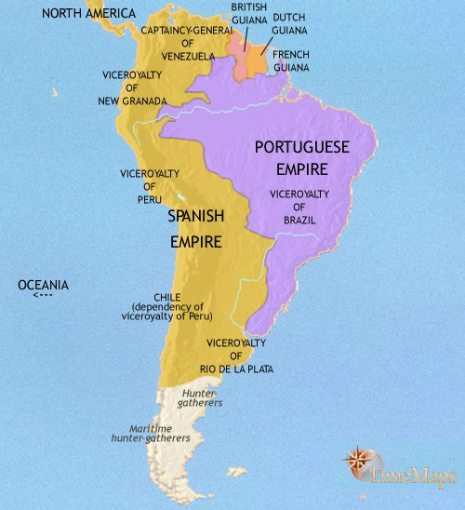
IMPERIAL LATIN AMERICA

Slide 26
QUIZ!

